Slide 1
Data Science: Big Data Management Systems & Tools
Module 4: Distributed Datastores

Slide 2
Module 4 Summary
Highly scalable distributed data storage systems
Learning Outcomes
Understand the benefits and drawbacks of distributed filesystems, database management systems and transactions
Explore the Hadoop Distributed Filesystem as a concrete example of a distributed filesystem, and
Complete a practical overview of Hadoop-related tools
Notes:
Callout: this module introduces us to the disturbed computing and how its different from traditional computing.

Slide 3
Scalability is an issue for relational databases
Recall that relational databases (RDBMSs) provide some great guarantees, in the form of the ACID properties (guarantee the validity of the stored data)
These guarantees are not easy for the database management software to maintain, and in fact, are not quite as guaranteed as promised by the vendors
Vendors allow small amount of failed transactions to go through,
RDB also use the concept of table joins to bring together data. However, joins are also computationally expensive operations
Joins can be very slow, which can make them impractical for large tables even if they fit on a single desktop or server
Notes:
Big data and scalability go hand in hand.
Relational databases are great for guarantee but those are expensive in processing time.
This gets really bad when you only have one server doing the expensive processing.

Slide 4
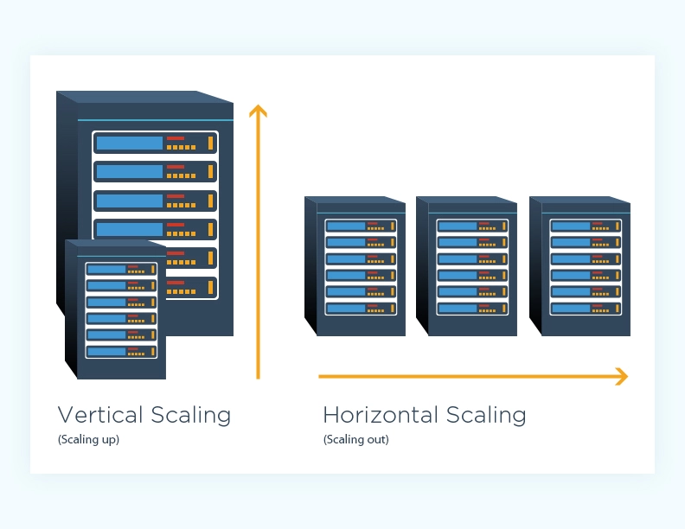
Scaling horizontally or vertically
The first way to address poor relational database performance is to use a faster server with more memory and/or CPUs (Scaling up or vertical scaling)
BUT, once you have the biggest and fastest server on the market, continuing to scale up is no longer an option
A more general solution is to scale out (horizontal scaling) by adding additional servers to create a cluster to distribute the data and load over
However, when we distribute data over several servers, the ACID properties become extremely difficult to maintain
Notes:
So one way to help a RDBMS is to use more power. You can do this by adding more memory to your server and this is called scaling up.
You might have experience this when you are running queries that take up to an hour to run as the serve many not be able to handle the request with its given memory.
The problem with this approach is that their is limit to how much memory you can add to a single server.
More general solution is to add more servers and distribute the data over those servers. This can allow for cheaper hardware as you do not need each machine to be super fast, but the whole collective to be fast.
But scaling horizontal has its flaws, specifically when it comes to adhering to ACID properties. Atomicity, Consistency, Isolation and Durability.
Example: lets say you want to update a certain record in the database that is horizontally scaled, you first need to find where its stored and then update them. This gets complicated as you have redundancy nodes.
Note that not everyone need to scale horizontally, it really depends on your business requirements.

Slide 5
Handling transactions on distributed systems
Scaling out results in distributed transactions, which means transactions may need to include tables that can no longer be assumed to be in the same database on a single node
Maintaining atomicity for a distributed transaction requires an additional software component called a transaction manager, which is used to track the transaction across the multiple nodes
There are two broad approaches that can be used to handle transactions across multiple machines and still attempt to comply with ACID properties, the two phase commit protocol and the compensation protocol
Notes:
Think of transaction as some change to a record, add, deleted, update, insert.
Node is just a server
Example: lets say we have a text file with names of students along with their courses and grades. Let’s say there are 1000 students in this file. When this data is loaded into a database, we might end up with a situation where each node has 100 students (10 x 100). Making an update to this setup requires a transaction manager in order to ensure that each node did what it was supposed to.

Slide 6
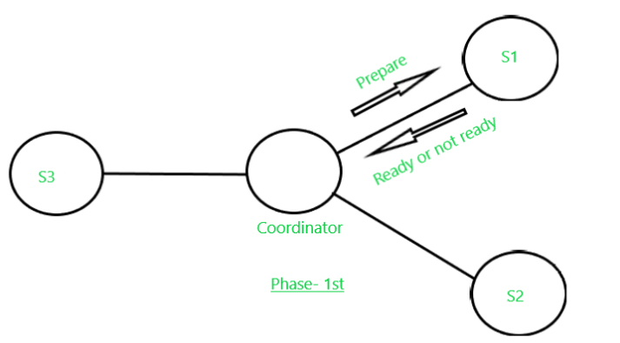
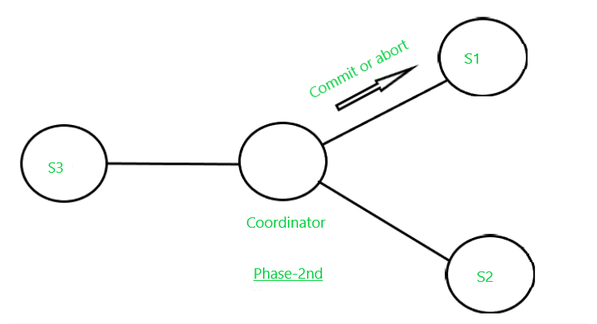
Two phase commit
1st phase: transaction manager sends a prepare request to all the nodes participating in the transaction
any node which receives a prepare request will also prepare the transaction data records to be committed or rolled back
The nodes then reply whether they expect to be able to complete their part of the transaction
any of the nodes replied no or did not reply after a reasonable amount of time, the transaction manager instead sends a roll back request to all nodes
2nd phase: If all nodes return a yes reply, then the transaction manager issues a commit request to all the nodes to complete the transaction
Note: This protocol requires a lot of communication back and forth between the servers and the transaction manager to maintain ACID which takes a hit on performance
Notes:
The first phase requires the transaction manager to send a prepare request to all the nodes participating in the transaction, asking them whether they can commit the data.
Any node which receives a prepare request will also prepare the transaction data records to be committed or rolled back.
The nodes then reply whether they expect to be able to complete their part of the transaction.
If all nodes return a yes reply, then the transaction manager proceeds to phase two and issues a commit request to all the nodes to complete the transaction.
If during the first phase any of the nodes replied no or did not reply after a reasonable amount of time, the transaction manager instead sends a roll back request to all nodes, triggering all of them to roll back.

Slide 7
Compensation e.g. the Saga Pattern
In this strategy, all servers immediately commit a distributed transaction (can later be reversed if necessary)
This works like a financial ledger: you can't delete an entry in the ledger but you can put through a reversing entry later if necessary to cancel it out.
This approach requires much more work by the system programmers, but ultimately it can be more reliable because the best way to back out of a failure may be application-specific
One has to keep in mind that the systems participating in a transaction may still temporarily be out of sync until any outstanding compensation requests have been received and processed.
Notes:
This is opposite of the last one, where the commit happens right after the request
The commit can then be rolled back via another request
This works similar to a financial ledger, no deletes, but can be cancelled by overwrite

Slide 8
CAP Theorem for distributed systems apps
For the successful design, implementation and deployment of applications in distributed computing systems, three interacting concepts:
consistency, availability and partition tolerance
The CAP Theorem states that in a distributed database system, it is only possible to achieve 2 of these 3 characteristics simultaneously:
C - All replicas of a dataset are consistent with each other
A - Users of the distributed database will always get a response to their query
P - If a system is partition tolerant it can continue to function if the nodes in the distributed database can't communicate with each other temporarily
The reason you can't have all three is that reliable ACID transactions are only possible if the network between them is always fully reliable, which it never is.
Notes:
Consistency is important - as there is not only distributed data, but the data is also replicated for redundancy purpose
P - if one node is down, the rest of the system should still work
The

Slide 9
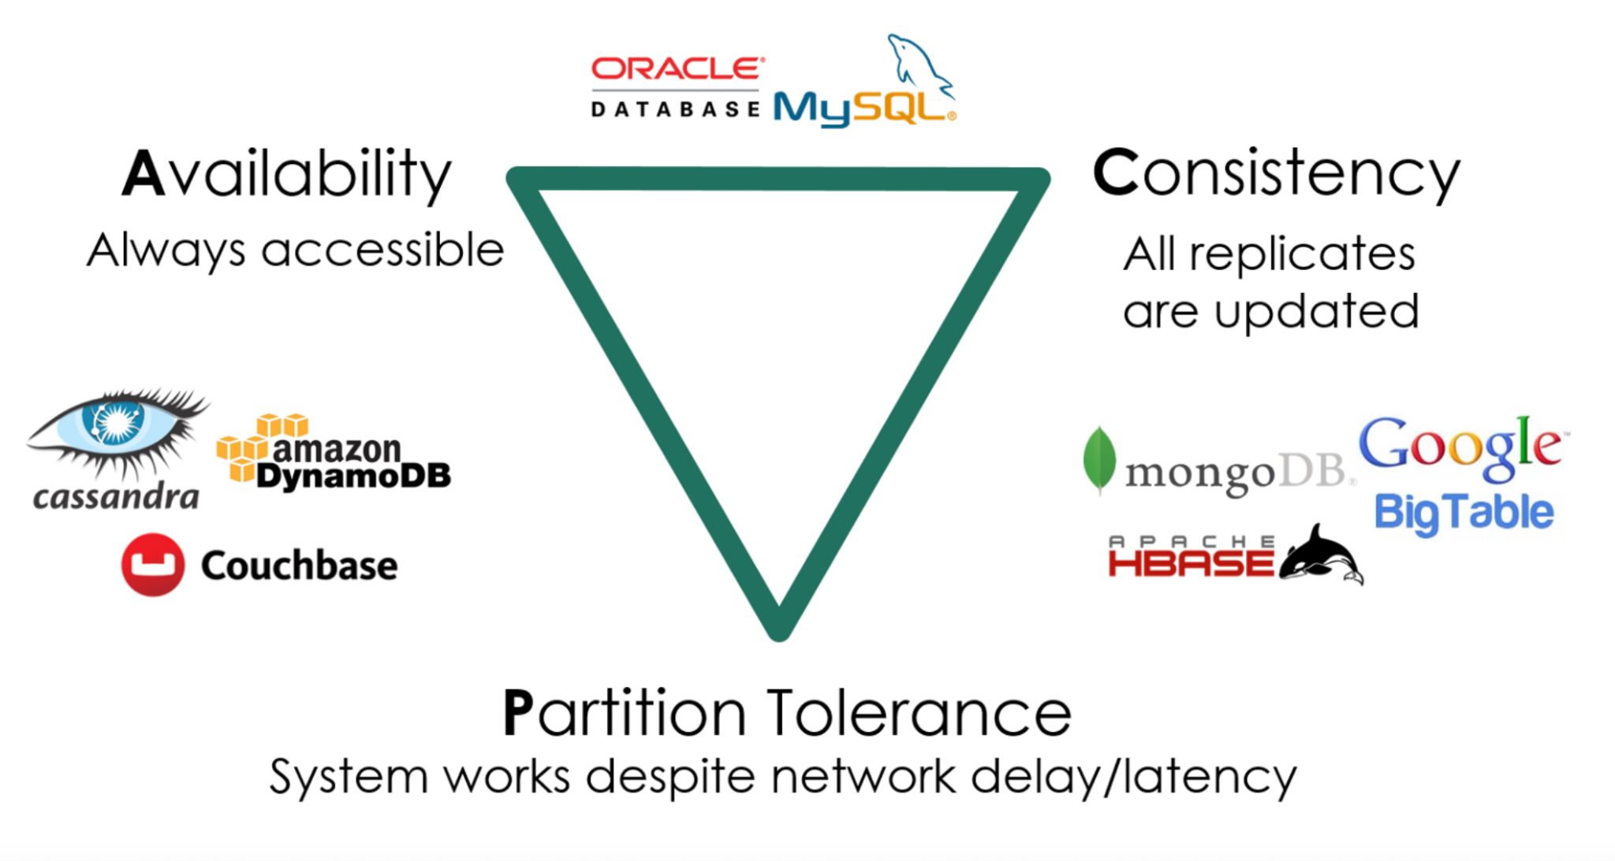
AP and CP preference
Database has no control over a partition conditions occuring, but can be designed with a preference for maintaining high availability (AP) over consistency (CP)
Notes:
Many of them allow for some tunable blend between AP and CP to fit the needs of a specific application
Some case a 5 second inconsistency might not be a problem - think for example a comment on facebook, but in other cases if a single difference can be a catastrophe

Slide 10
Using BASE instead of ACID
NoSQL vendors quickly came up with a catchy name for their alternative to ACID
Basically Available (BA) - The system guarantee a response to any request but that response could still be "failure"
Soft State (S) - The state of the system can change over time, so even during times without input there may be changes going on due to eventual consistency.
Eventually Consistent (E) - The system will eventually become consistent once it stops receiving input
Notes:
How do we deal with a loss of consistency and still maintain system reliability?

Slide 11
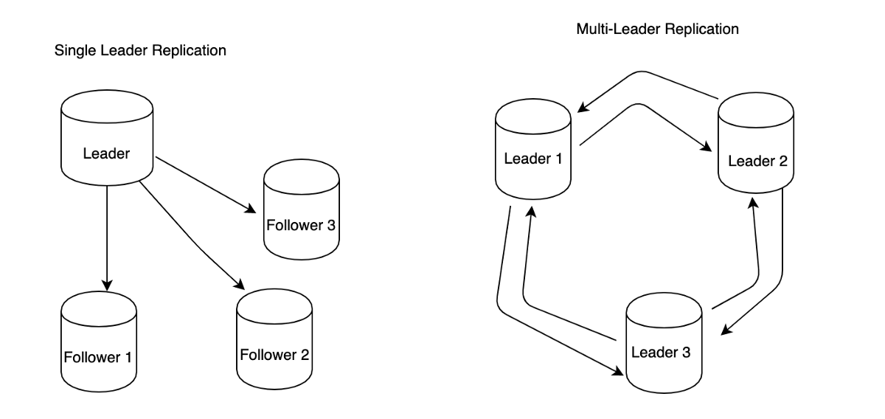
Splitting data with replication
Replication refers to the process of replicating across different nodes. The main benefits of replication are:
Fault tolerance: multiple copies of the same data are replicated on different nodes
Latency reduction: replicas placed geographically closer to users, to speed up delivery
Scalability: processing more requests per unit time than a single machine can handle
There are different types of replication strategies that are used for handling data changes
Single leader replication
Multi leader replication
Leaderless replication
Leaderless introduces a new drawback since we don’t know what the correct order of the data updates is
Notes:
Single Leader: A leader node is selected from all the nodes while other nodes are called follower nodes. New data for writes is sent to the leader only. The leader then sends a replication log to the followers which perform the same updates to their data replicas.
Multi-leader replication : allows more than one node to accept writes. Each node that receives and processes a data change forwards that change to all other nodes. This results in great write performance but poor consistency.
Leaderless replication:once again any replica can accept writes. Here the nodes all operate as peers. If nodes go down or lose network connectivity they can catch up on missed data from any of the others. There is a special background process called an anti-entropy process that runs in the cluster and looks for differences between replicas and copies any missing data from one replica to another.
This would seem like the best solution, but the CAP theorem guarantees that we have to lose something in return for the apparent good performance, availability and consistency. The drawback is that another kind of inconsistency creeps in. We have no way of knowing what the correct order of the data updates is.

Slide 12
Splitting data with partitioning
Sharding (also called horizontal partitioning) is a common partitioning approach, where the key of each data record is used to assign each record to a partition
Another type of partitioning, called vertical partitioning, is used to divide a large dataset such as a million-record table into smaller tables by record type
Partitioning is usually combined with replication, copies of each partition are stored on multiple nodes
Although partitioning has many benefits it does introduce some complications:
some partitions can have more data than other partitions
some partitions might be queried more often than others
over time, databases changes may cause some partitions to grow or shrink relative to others
Well-established NoSQL databases usually provide some kind of built-in rebalancing strategy to attempt to monitor partition sizes
Notes:
Single Leader: A leader node is selected from all the nodes while other nodes are called follower nodes. New data for writes is sent to the leader only. The leader then sends a replication log to the followers which perform the same updates to their data replicas.
Multi-leader replication : allows more than one node to accept writes. Each node that receives and processes a data change forwards that change to all other nodes. This results in great write performance but poor consistency.
Leaderless replication:once again any replica can accept writes. Here the nodes all operate as peers. If nodes go down or lose network connectivity they can catch up on missed data from any of the others. There is a special background process called an anti-entropy process that runs in the cluster and looks for differences between replicas and copies any missing data from one replica to another.
This would seem like the best solution, but the CAP theorem guarantees that we have to lose something in return for the apparent good performance, availability and consistency. The drawback is that another kind of inconsistency creeps in. We have no way of knowing what the correct order of the data updates is.

Slide 13
Apache Hadoop
Apache Hadoop is an ecosystem of software modules and frameworks
Collectively form a highly scalable system for doing analytics on massive datasets (petabytes)
Open-source framework initially released in 2007
Fault tolerant
Highly available
Three major components:
Hadoop Distributed File System (HDFS) (storage)
Hadoop MapReduce (processing)
Hadoop Yarn (resource and process management)
Includes many more utilities provided by Apache, and also other open-source projects
Also includes cloud-based distributions (AWS, Windows Azure HDInsight)

Slide 14
Popularity of Hadoop
Doesn't need high end computers
Can use commodity hardware
Parallel processing
Platform for many Big Data implementations
Some corporations using Hadoop:
Facebook, Amazon, eBay, IBM, and more
Related jobs:
Developers
Administrators
Architects

Slide 15
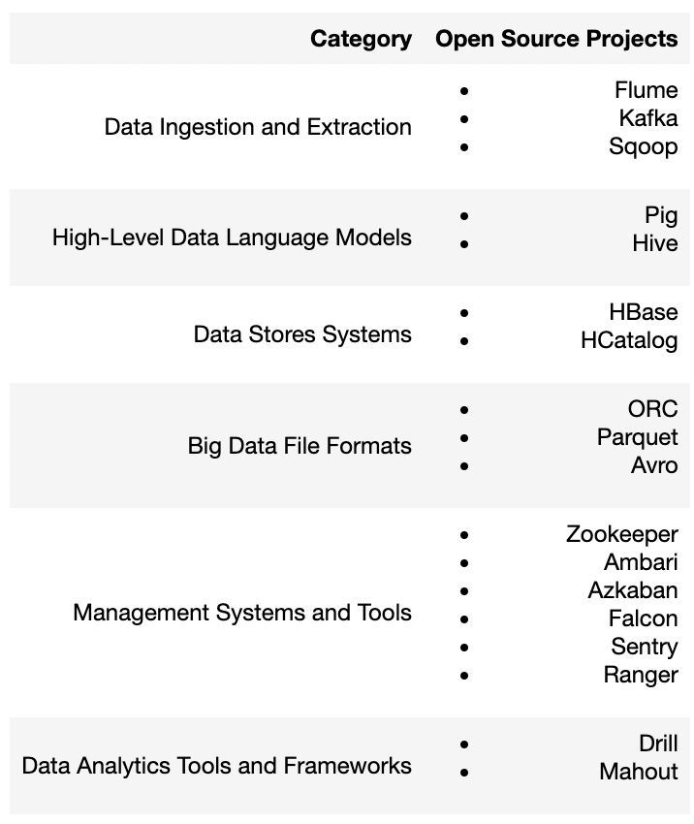
The Hadoop Ecosystem

Slide 16
Hadoop architecture
As an administrator, I can manage the health of a Hadoop system
Ambari
As a data engineer or data scientist I can access tools to work with my data
Pig
(Scripting)
Spark
(SQL, ML)
Hive
(SQL)
Impala
(SQL)
YARN will manage the resources my job will get
YARN
Data Ingestion tools:
Kafka, Flume, Sqoop
The data I work with in Hadoop is stored in a file system
HDFS (Hadoop File System)
Admin can leverage Ranger\Sentry to govern who can access specific data

Slide 17
How data is stored in HDFS
Remember Distributed Systems are made up of a bunch of nodes (computers) that work to process data in parallel!
Some nodes are Leaders and some are Workers
Leader = knows where data is stored, knows info (metadata) about the data files, replicates the data across the nodes
Worker = stores the data itself so it can be processed

Slide 18

How data is stored in HDFS
Note that the Leader nodes keep track of where the blocks for this file are located and what they data is about
Let’s ingest this file to Hadoop
Step 1: partition the file into blocks
Step 2: replicate these blocks 3x across the Worker Nodes
Outcome:
The data is stored in HDFS
Fault tolerance: data is replicated so if one data node goes down, the data is still accessible in another
The three pieces (blocks) of the original data file can be processed in parallel!
1
Hello World!
1
2
3
Hello World!
My name is Melissa.
I am a Software Engineer.
2
My name is Melissa.
1
3
1
2
3
2
3
I am a Software Engineer.

Slide 19
Hadoop management system
Hadoop can be a large, expensive, complex distributed system
Organizations want to make sure the system is functioning optimally
The following tool can be used for management purpose:
Ambari: Is a management platform that provisions, manages, monitors, and secures Hadoop clusters.
Azkaban: Is a workflow manager to define and run Hadoop jobs
Falcon: Is a data governance tool that allow users to define, schedule, and monitor data management policies.
Sentry: Is system that enforces fine-grain security policies on the data in a Hadoop cluster.
Zookeeper: Is a centralized service for maintaining configuration information, naming, providing distributed synchronization, and providing group services

Slide 20
Getting data in and out of Hadoop
Moving large amounts of data can be challenging
There are two commonly used projects that focus on ingesting data into Hadoop:
Flume: Provides a highly scalable and reliable system that specializes in moving large amounts of streaming or batch data into HDFS or HBase
Kafka: A general purpose publish-subscribe messaging platform that is also highly scalable and reliable

Slide 21
RDBMS vs NoSQL
Criteria | SQL Databases | NoSQL Databases
Structure | Relational, structured schema and predefined tables (e.g. table-based) | Non-relational, flexible schema with various data models (document, key-value, graph, etc.)
Data Integrity | Strong with ACID properties | Sometimes weaker consistency with BASE
Query Language | SQL for complex joins and queries | Varies
Scalability | Vertically | Horizontally with sharding and replication
Use Cases | Complex queries Multi-row transactions, Data consistency Systems with consistent schema and relations (e.g. inventory management, financial systems) | Large volumes of unstructured, semi-structured data or structured data, Changing schema, High write concurrency (e.g. millions of concurrent users), Real-time analytics and High availability (e.g. social media platforms and IoT devices for streaming)

Slide 22
RDBMS vs NoSQL
Criteria | SQL Databases | NoSQL Databases
Cost | Generally more expensive for technology due to vertical scaling (need powerful hardware) | Can be more inexpensive as commodity hardware can be used in cluster
Flexibility | Weaker due to predefined schema but higher consistency | Higher due to schema-less design and support of unstructured data, but may sacrifice one property of CAP theorem
Transaction Management | Strong transactional support with ACID compliance | Limited transactional support as it doesn’t have ACID compliance but higher efficiency
Complexity | Higher complexity for schema design | Easier to create data model and load data (as no predefined schema is needed) but can be harder to manage all nodes in cluster
Cost of Maintenance | It depends. Need specialised DBAs and more expensive hardware. | Can use commodity hardware but need large IT team to manage complex cluster unless using Cloud Providers for PaaS, IaaS or SaaS

Slide 23
When to choose what - SQL vs NoSQL?
Sometimes both systems can be suitable but it depends…
Property | Activity | NoSQL Databases
High read performance | Search through a product catalog quickly | Both can be performant! SQL can use indexing and NoSQL partitioning/distributed computing
Caching for Frequently Accessed Data | Adding and viewing products in cart. User session details after login | NoSQL quickly snaps pics of products and stores in cache for fast retrieval if user needs to view what’s in cart. Key-value pair for cached session data.
Concurrency Control for Write Operations | Many customers are adding products to their carts at the same time | Both. SQL provides ACID support to guarantee the transaction (all or nothing). NoSQL has less of a guarantee for the transaction but also implements similar All or Nothing paradigm and is higher performant for high write concurrency
 | What if it’s Black Friday and there’s a surge of concurrent users? | NoSQL can handle high write concurrency through distributed computing.

Slide 24
When to choose what - SQL vs NoSQL?
Property | Activity | NoSQL Databases
Scalability | Growing the system as more people start to use the store. Black Friday is coming up and the # of users is unprecedented! | NoSQL as it uses horizontal scaling. More efficient to add more memory, CPU and storage with little downtime and do not hit a ceiling.
Real-time Data Updates | Streaming GPS data from trucks that are delivering product to stores to track where they are, speed, etc. | NoSQL combined with streaming tools like Kafka/Flume can receive and write data in real-time without having to know the schema or needing to modify the data.
 | People buy something and the website updates right away. | Both BUT NoSQL can be more efficient for this transaction where there’s high write concurrency.
Schema flexibility for Varied Data | Adding new attributes for product features to the product catalog | Both BUT SQL is much more rigid and changing the database structure is costly and takes time. NoSQL is the winner for this use case with it’s schema-less design

Slide 25
When to choose what - SQL vs NoSQL?
TL;DR:
SQL ensures transactions are safe and fares well with moderately high site traffic and low to moderate changes to schema.
NoSQL brings flexibility for being able to adapt and move quickly with unpredictable changes in e-commerce (e.g. product changes, spike in site usage, caching frequently accessed data, etc.)

Slide 26

Application of RDBMS, NoSQL and Hadoop
We are engineers that work at a Grocery Store that spans across the nation!
2.4k stores | 200k employees | 15 MM customers | 32 distribution centers | 8k Trucks
E-commerce website
Can support 10 MM online users
Can support real-time changes to inventory
Can support shopping cart
Real-time truck tracking
Truck speed
Distance to destination
Destination history
Reefer fuel
How long truck is idle
Data
Employee
Product
Customer
Real-time truck data
Customer transactions (POS, online, etc.)
Surveys on customer sentiment
Merchandise Management System
Support manager requests for inventory
Automatically send inventory count to warehouse
Support automated inventory orders
Analytics & Reporting
Optimize routes
How to optimize transportation
How to be proactive on truck maintenance
Promoting products to customers
Understanding customer behaviour
Seasonal purchase behaviour
Quarterly profits, expenses, etc.
Design considerations:
Can we easily scale to support growing user base?
Can we support ingesting real-time truck data?
Will our website be available 24/7?
How do we manage all of our data systems?
How do we update one application without impacting the other?

Slide 27


RDBMS
We are engineers that work at a Grocery Store that spans across the nation!
2.4k stores | 200k employees | 15 MM customers | 32 distribution centers | 8k Trucks
E-commerce website
Can support 10 MM online users
Can support real-time changes to inventory
Can support shopping cart
Real-time truck tracking
Truck speed
Distance to destination
Destination history
Reefer fuel
How long truck is idle
Use Cases:
Regulatory reporting
Financial reporting
Descriptive & Prescriptive Analytics for business optimization
Why are these use cases suited for RDBMS?
Data integrity is important
Real-time querying is not needed
Data is in tabular format (structured)
Merchandise Management System
Support manager requests for inventory
Automatically send inventory count to warehouse
Support automated inventory orders
Analytics & Reporting
Optimize routes
How to optimize transportation
How to be proactive on truck maintenance
Promoting products to customers
Understanding customer behaviour
Seasonal purchase behaviour

Slide 28
NoSQL
We are engineers that work at a Grocery Store that spans across the nation!
2.4k stores | 200k employees | 15 MM customers | 32 distribution centers | 8k Trucks
E-commerce website
Can support 10 MM online users
Can support real-time changes to inventory
Can support shopping cart
Real-time truck tracking
Truck speed
Distance to destination
Destination history
Reefer fuel
How long truck is idle
Why are these use cases suited for NoSQL?
handles heavy read-and-write traffic
scale data repository to massive size
scale db for web applications to support rapidly growing user base
supports large # of concurrent users
can search data with text, geospatial or time-series Dimensions
Merchandise Management System
Support manager requests for inventory
Automatically send inventory count to warehouse
Support automated inventory orders
Analytics & Reporting
Optimize routes
How to optimize transportation
How to be proactive on truck maintenance
Promoting products to customers
Understanding customer behaviour
Seasonal purchase behaviour

Slide 29
Why is this important?
In a 24/7/365 world you need high reliability with near-zero downtime
You can only do this by introducing distributed duplicates
You can’t keep distributed duplicates perfectly synchronized
So: You need to make well-reasoned decisions about the trade-offs based on business needs

